Slide 1
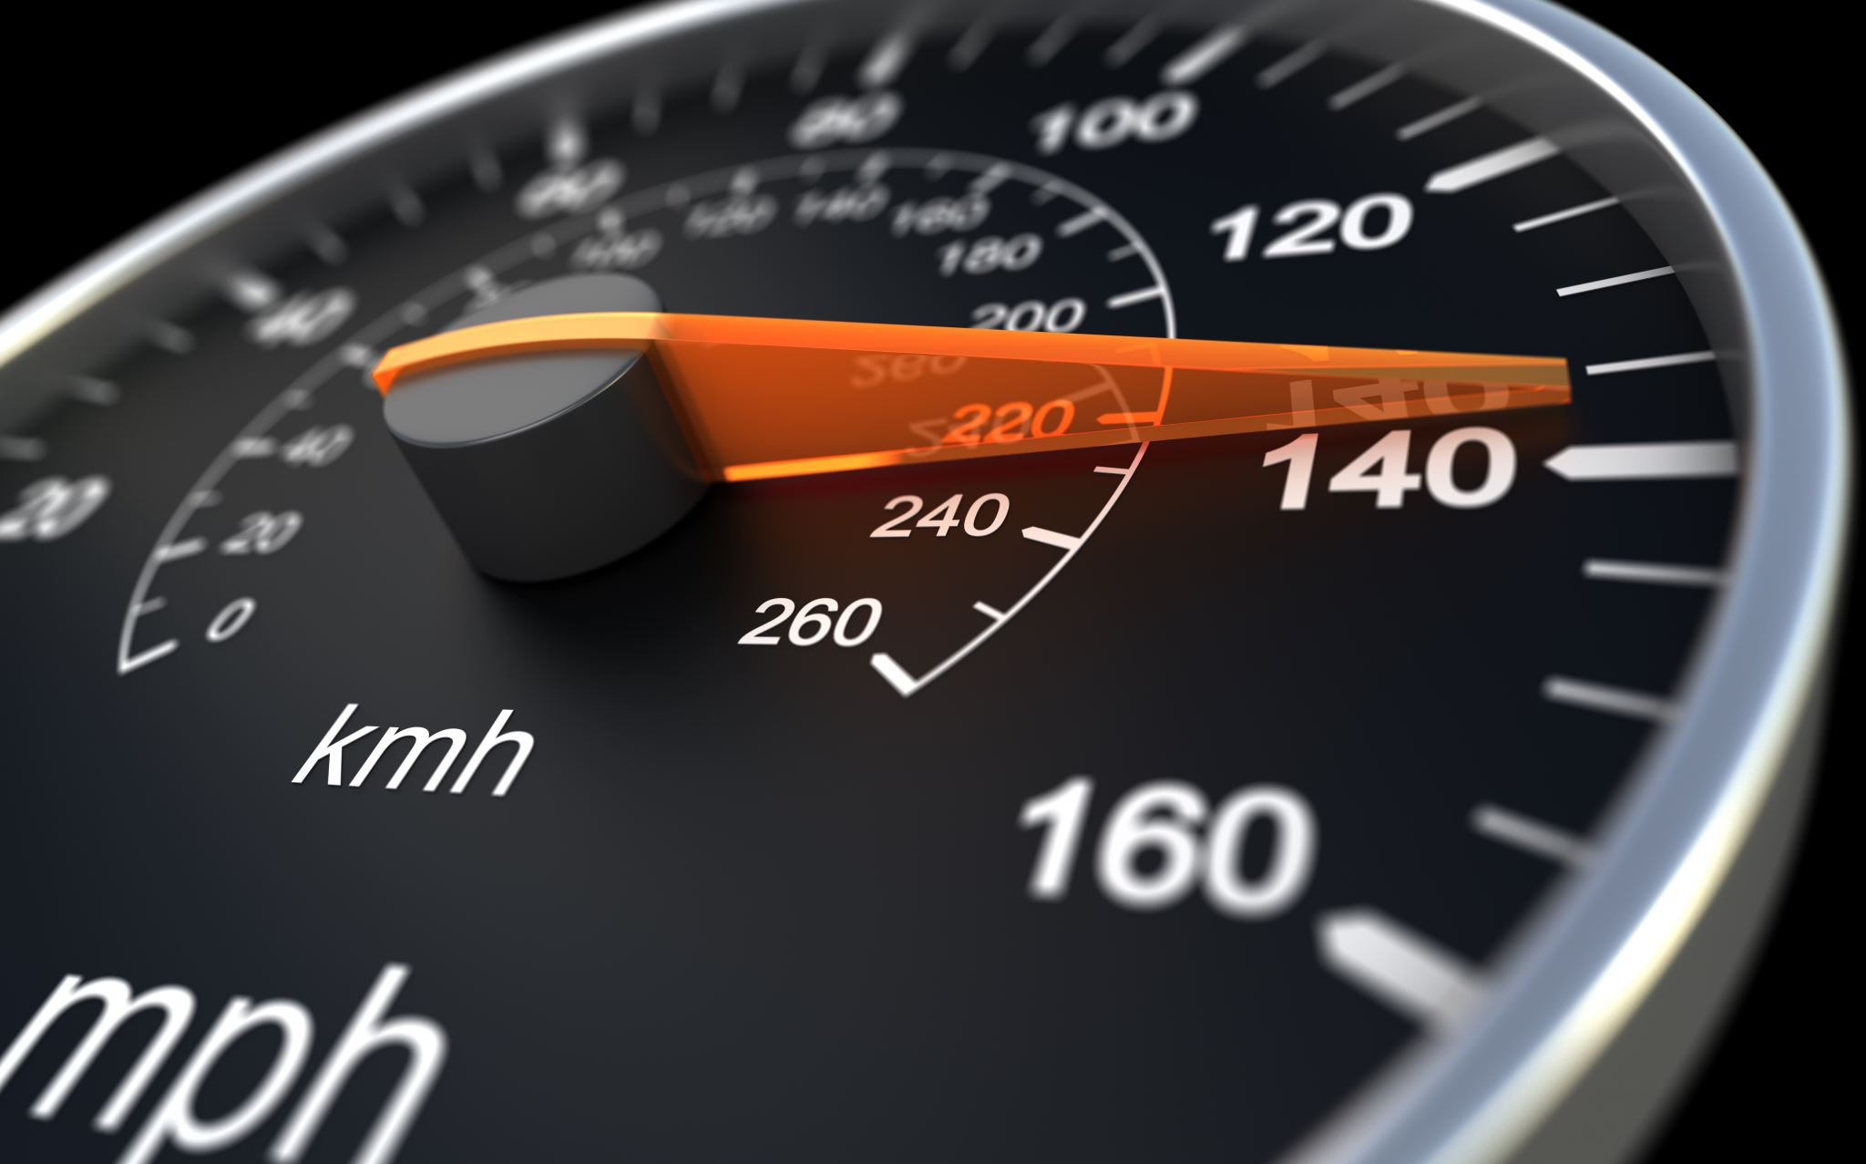
DS Engine
Team Road Killer
Notes:
Good morning everyone, we are team road killer and the engine we made is called DS Engine. DS means driving simulator.

Slide 2
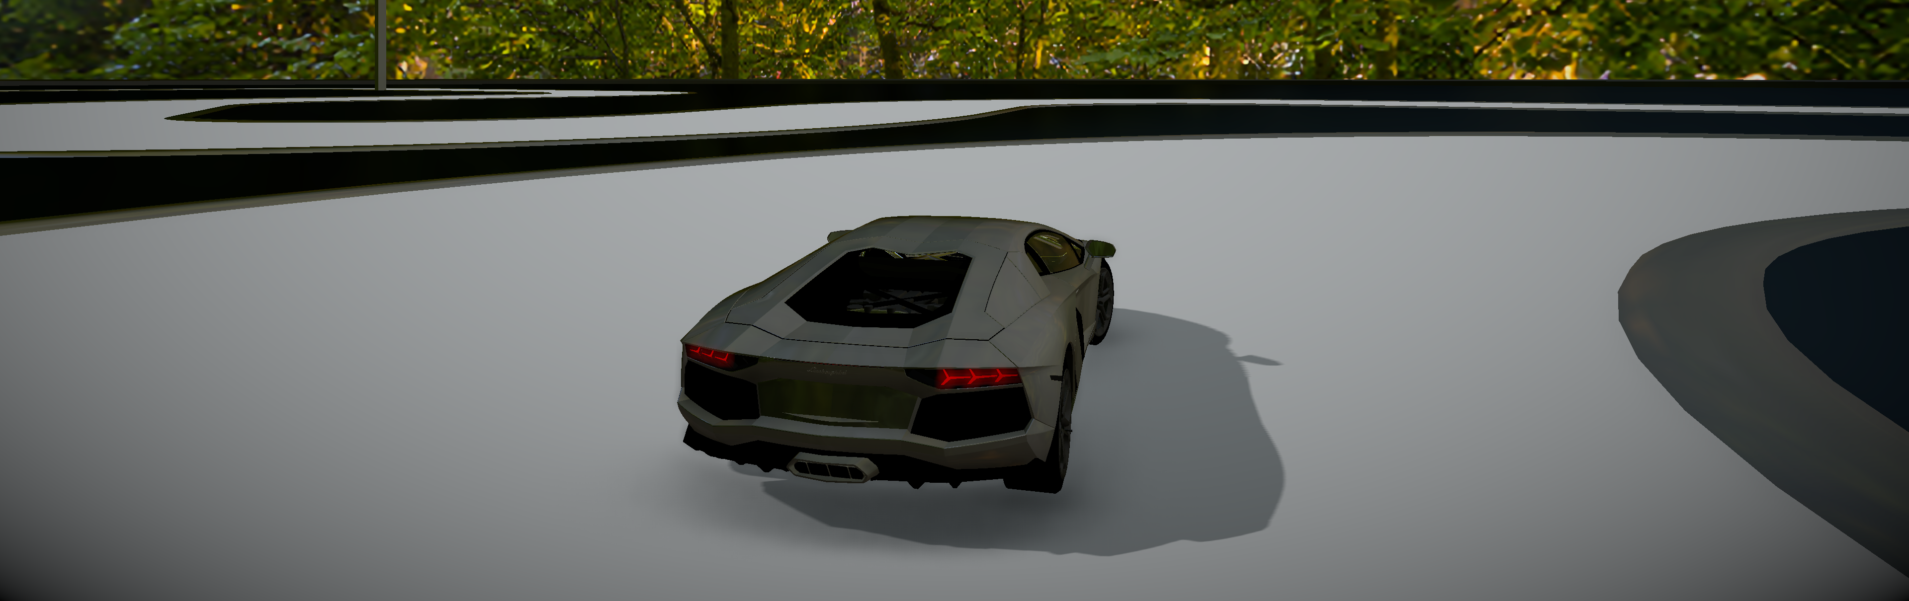
The Product
Notes:
Before we start, here’s a screenshot of our final product.

Slide 3
The Product
What We Have
What We Don’t Have
Game Loop
Rendering
Scene Graph
Physics
3D Audio
Input
Multicore
Memory Management
File Representation
Partitioning
Resource Manager
…
Notes:
We made many decisions about what should be in our engine. Those on the left because we need them, and I’ll mainly focus on what we don’t have.
So we have …
What we don’t have:
Multicore. We don’t have a very good reason of using a multicore/multithread system, so we decided to focus on the functionalities we need first.
Memory Management. We are using new and delete in our engine because it’s not yet a bottleneck of performance.
File Representation. This is a functionality that we’d like to have but we don’t have time for it and it turns out to be ok to not have it.
Partitioning. We don’t have a huge scene thus this is on the lower part of the priority list and we don’t have time for it.
Resource Manager. This could be a huge optimization to what we have now, but it will be easier if we have file representation.
Many other things, just because we don’t need them.

Slide 4
Progression
Idea
Preparation
Architecture Design
Fundamental Functionalities
Working in Parallel
Rendering
Input
Physics
Audio
Application
Notes:
Next, I’ll tell you how we get here from an idea.
After the idea generation, we made some research on the feasibility of the project. We also studied what libraries we need and how to manage them properly to have a better work flow.
Then, we designed the architecture carefully, and made the fundamental functionalities for an engine like scene graph and game loop first.
After that we started to work on each one’s part parallelly. And finally after most of the systems are done we started to use our engine to make the game to test the functionalities.

Slide 5
The Idea
Rendering
Physics
Audio
Notes:
The idea of this project is very simple. One of us wants our game to have good looking. One of us wants to focus on physics. One of us wants to make some audio effects. So we decided to make a racing game.

Slide 6
The Technologies
Coding Environment
Visual Studio 2017
Visual Studio 2019
Azure Pipelines
vcpkg
Doxygen
Notes:
Next I’ll talk about the technologies we used. First is coding environment. We used both VS2017 and VS2019 in this project. At the time we started to use VS2019, it’s still in preview, but the performance of the IDE itself, and its new compiler is amazing. We used Continuous Integration for this project. The Azure Pipelines, originally Team Foundation Server, has great integration with VS and it provides 10 free parallel jobs for a free account. We used vcpkg from Microsoft as our package manager for C++. It has some pros and cons. The pros includes that it compiles everything from source to prevent linking problem; it can handle the linking automatically if you are using VS or cmake, and adding a package is very easy but one doesn’t need to do that often since there are many packages supported. The cons includes it compiles from source which will take a huge amount of time and disk space, and if you are using VS and want automatically linking you’ll need to have administrator privilege and write access to VS install folder which we don’t have on lab computers and it causes us some trouble. Finally, we used doxygen for automatic documentation generation. It makes us much easier to understand each other’s code.

Slide 7
The Technologies
Coding Environment
System Libraries
DirectX 11
XAudio2
XInput
Notes:
Next, libraries provided by system. We are using Direct3D 11, XAudio2 and Xinput. They all come from DirectX API and provided by the system. And they have the same API design which makes it easier for us to make something on that. And they are all very powerful low-level libraries.

Slide 8
The Technologies
Coding Environment
System Libraries
3rd Party Libraries
Boost
FFmpeg
Assimp
Notes:
We used boost, ffmpeg and assimp in the project. Boost is used for multithreading, logging, uuid generation and other stuff. Ffmpeg is for decoding the audio file. Assimp for importing the 3d models.

Slide 9
Architecture
Game Logic
DS Engine Application
Rendering
Input
Audio
Physics
DS Engine Framework
Direct3D
XInput
XAudio2
FFmpeg
…
Notes:
Next is our architecture. On the bottom, we have those libraries we talked about. We have a simple wrapper on those libraries so we don’t need to manipulate raw APIs in our systems. We call this wrapper the DS Engine Framework. Then, we have our systems working on that framework. And a base application is responsible for communicating with systems, and the game loop. On the top most level, we have the user side game logic.

Slide 10
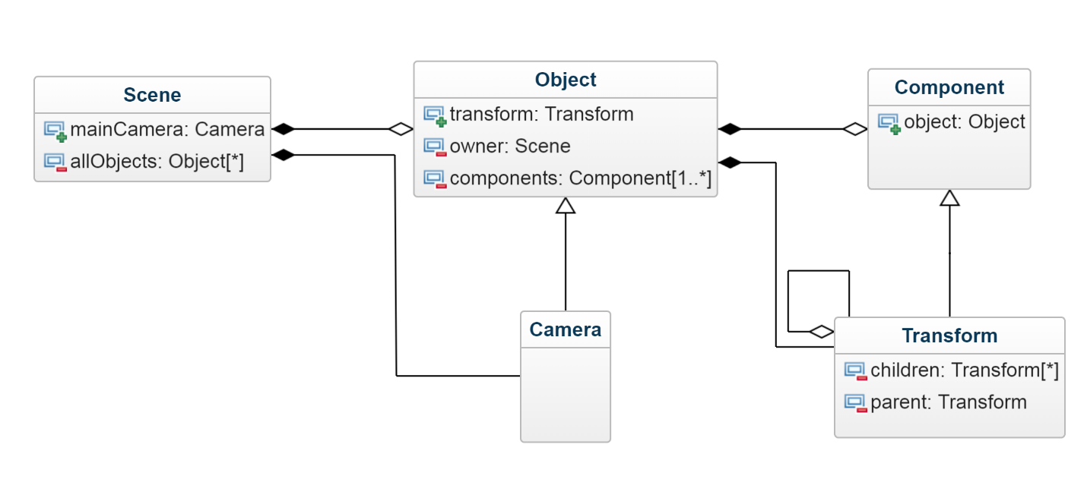
Scene Graph
Entity-Component
Notes:
Our scene graph is entity-component and very unity-like. A scene have multiple objects and an object can have multiple components. The objects are stored in a list. One of the special components is transform. It contains the position, rotation and scale data and the parent-child relationship. A transform can have at most one parent and any number of children. So, very unity-like.

Slide 11
Input System
Unity-like
Notes:
Next I want to talk about our systems.
The input system is also very unity-like. Since we don’t have file representation we can’t store the input data in a file and we have to register inputs at the application initialization stage. After that just use it as in unity.

Slide 12
Input System
Unity-like
Register at application initialization
SInput->RegisterInput("Horizontal", "d", "a", "", "", 10.0f, 0.1f, 10.0f, false, Button, MouseX, -1);
SInput->RegisterInput("Horizontal", "", "", "", "", 10.0f, 0.1f, 10.0f, false, Axis, JoystickLX, -1);
float horizontal = SInput->GetAxis("Horizontal");
Notes:
Next I want to talk about our systems.
The input system is also very unity-like. Since we don’t have file representation we can’t store the input data in a file and we have to register inputs at the application initialization stage. After that just use it as in unity.

Slide 13
Input System
Unity-like
Register at application initialization
Run time function binding at registration
/**
* @brief The get button functions.
*
* 0: positive, 1: altPositive,
* 2: negative, 3: altNegative
*/
std::function<bool()> getButton[4];
DSJoystickButtonCode buttonCode = GetJoystickButtonCodeFromName(buttonName);
if (buttonCode == RESERVED_0)
{
getButton [buttonFuncIndex] = [buttonName]() { LOG_ERROR << "Joystick Button \"" << buttonName << "\" Can Not Be Parsed!"; return false; };
getButtonDown[buttonFuncIndex] = [buttonName]() { LOG_ERROR << "Joystick Button \"" << buttonName << "\" Can Not Be Parsed!"; return false; };
getButtonUp [buttonFuncIndex] = [buttonName]() { LOG_ERROR << "Joystick Button \"" << buttonName << "\" Can Not Be Parsed!"; return false; };
}
else
{
getButton [buttonFuncIndex] = std::bind(&DSFXInput::GetButton, &inputSystem->xInput, buttonCode, joyNum);
getButtonDown[buttonFuncIndex] = std::bind(&DSFXInput::GetButtonDown, &inputSystem->xInput, buttonCode, joyNum);
getButtonUp [buttonFuncIndex] = std::bind(&DSFXInput::GetButtonUp, &inputSystem->xInput, buttonCode, joyNum);
}
Notes:
When registering, the system will parse the button names and get the input type, and then it will bind the desired function during run time. By doing this, we can reduce a huge number of string comparisons in the game loop.

Slide 14
Input System
Unity-like
Register at application initialization
Run time function binding at registration
High-frequency joystick input polling (250Hz)
Notes:
Finally, we have a high-frequency joystick input polling working on another thread. This can reduce the input latency greatly if we are on a low framerate.

Slide 15
Rendering System
Forward Rendering
Physically Based Rendering
User customized material
Post Processing
Notes:
The rendering system is rather simple. We are using forward rendering, we have an OK pbr. The engine supports user customized material, and we have a pipeline that supports post processing. And Since we are also using this engine in graphics course, we got an extra bonus on our rendering system.

Slide 16
Physics System
Sphere Collier
Box Collider
Wheel Collider
Rigid Body
Ray Cast

Slide 17
Car physics
Straight line physics
Steering

Slide 18
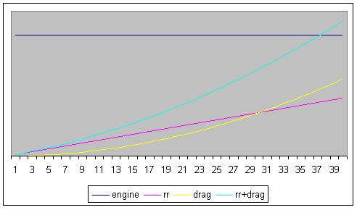

Straight line physics
$F_{long}=\frac{F_{traction}}{F_{braking}}+F_{drag}+F_{rr}$
$F_{traction}=u⋅F_{Engine}$
$F=−u⋅F_{Engine}$
$F_{drag}=−C_{drag}∗v∗\left|v\right|$
$F_{rr}=−C_{rr}⋅v$
$a=\frac{F}{m}$
$v=v+a⋅dt$
$p=p+v⋅dt$

Slide 19
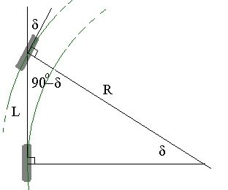


Steering
$$\sin{δ}=\frac{L}{R}↔R=\frac{L}{\sin{δ}}$$
$$ω=\frac{v}{R}$$

Slide 20
Audio System
Unity-like: AudioSource & AudioListener
FFmpeg for decoding
XAudio2 for playback
Streaming from disk
3D Audio with X3DAudio
Notes:
For the audio system, we also made it unity-like. We have audio sources and an audio listener. We are using Ffmpeg for decoding audio files, and XAudio2 for playback. And the audio is streamed from disk instead of being loaded to the memory altogether. And we made 3D audio effects including panning and doppler effects with X3DAudio, a subset of the XAudio2 API.

Slide 21
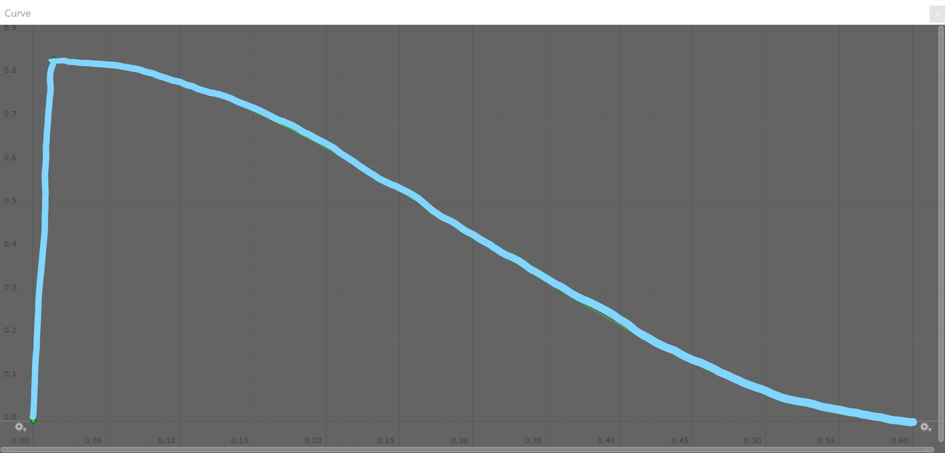
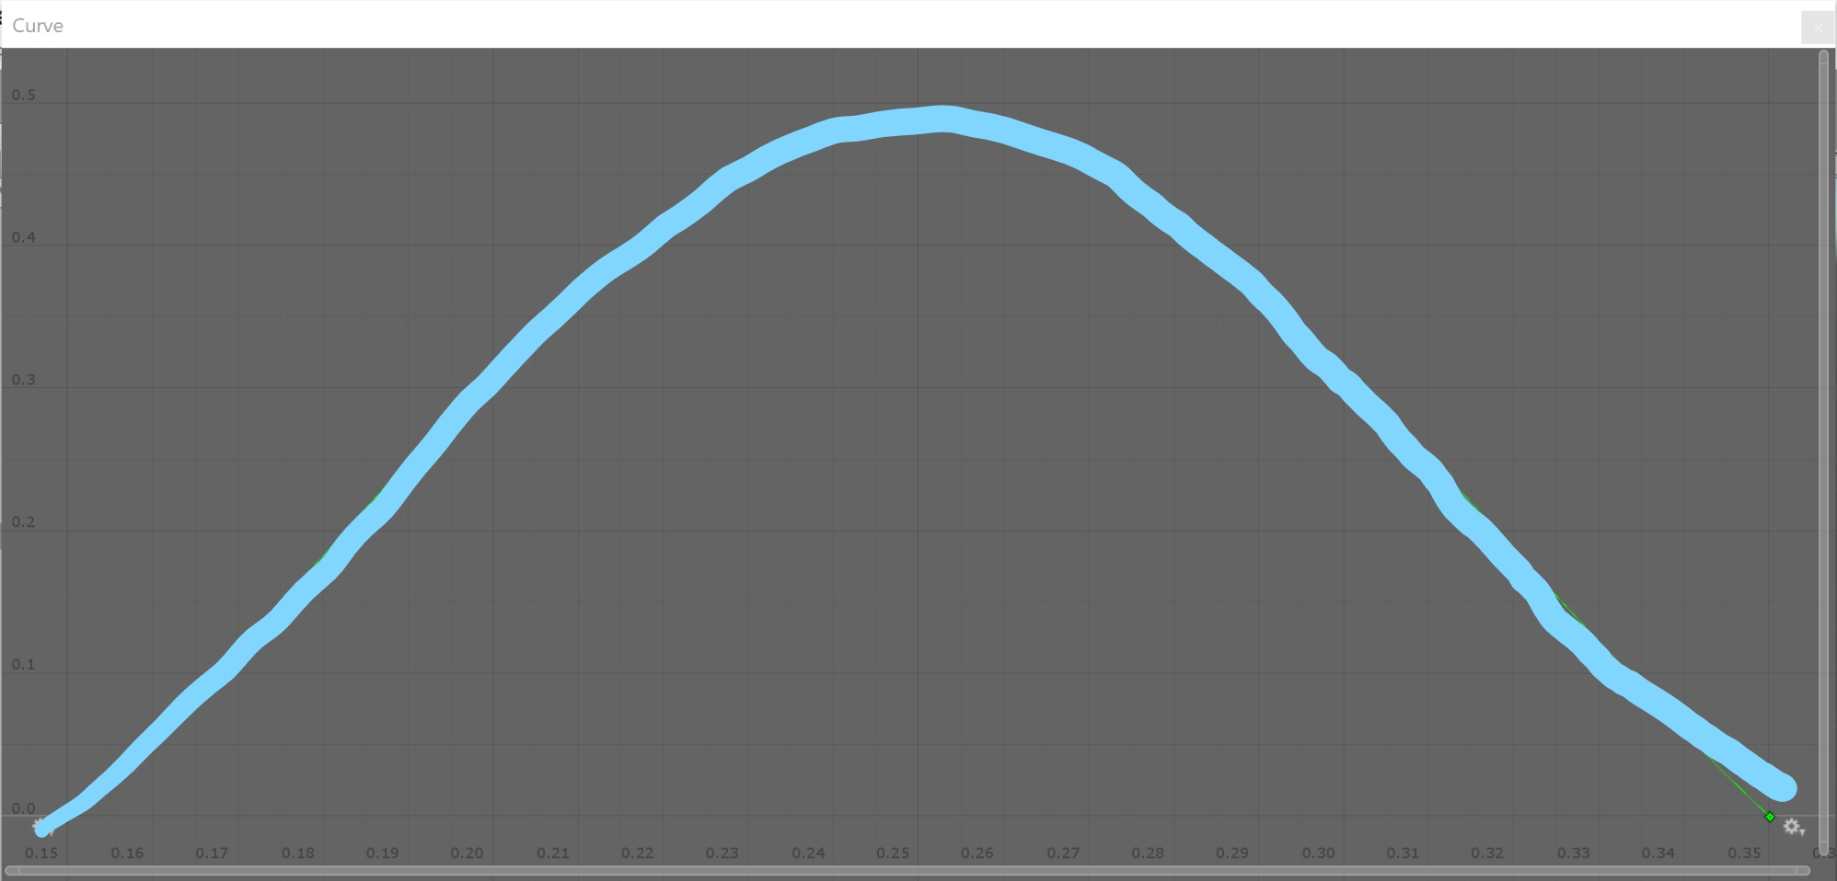
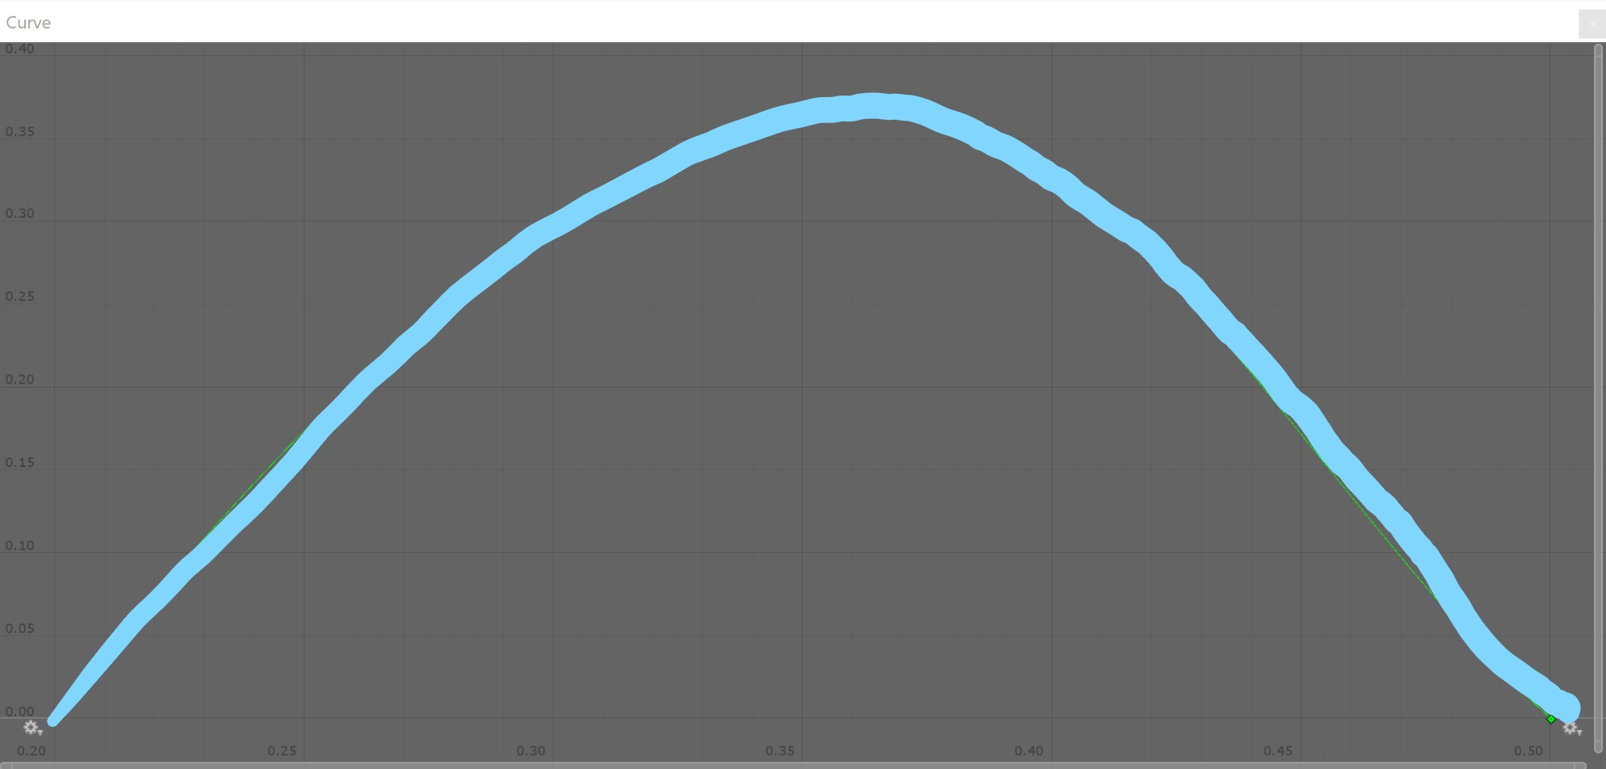
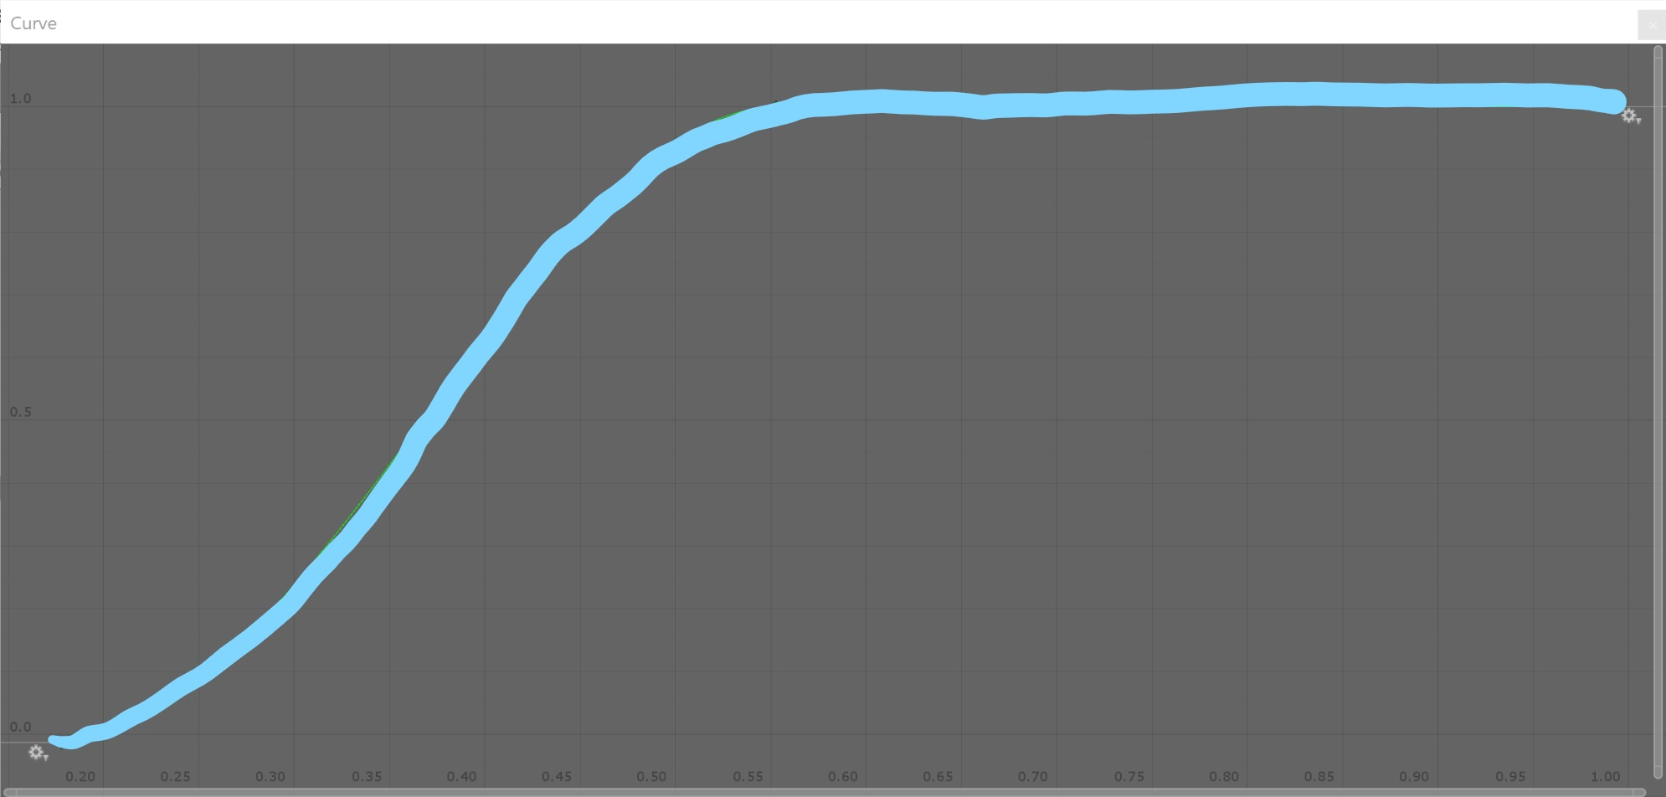
CAr audio
Volume
Idle
Volume
Low
Volume
Mid
Volume
High
RPM/MaxRPM

Slide 22
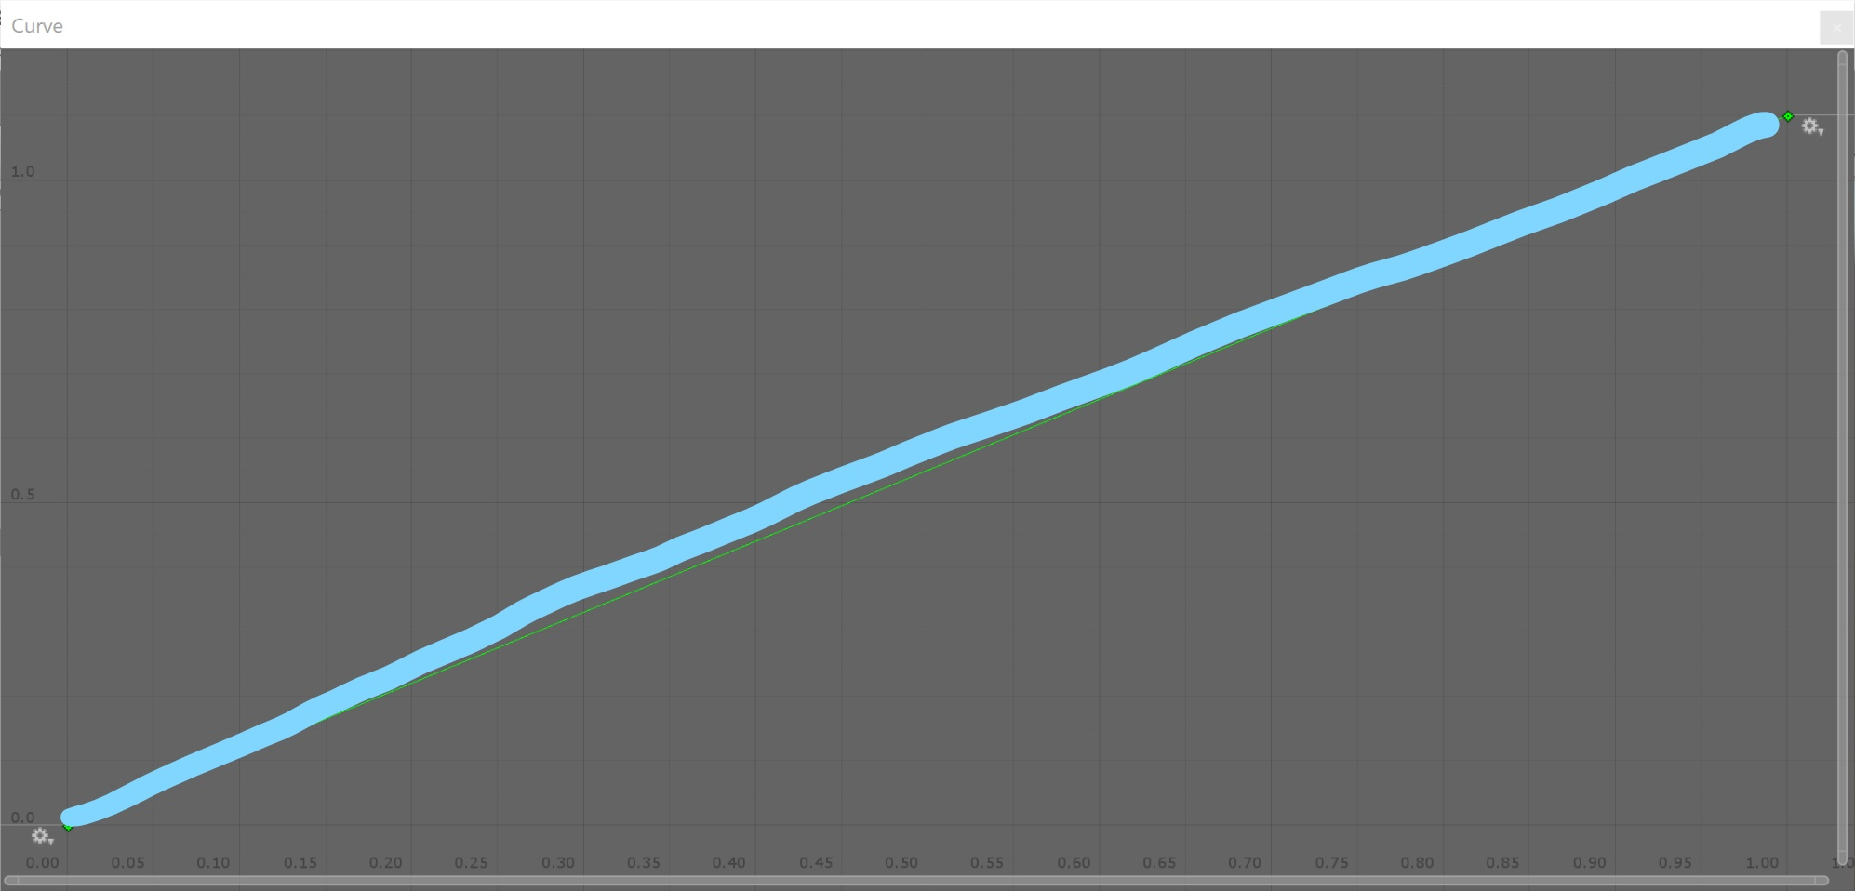
CAr audio
Pitch
Idle
Pitch
Low
Pitch
Mid
Pitch
High
RPM/MaxRPM

Slide 23
Postmortem
Careful research and proper capability assessment
The project isn’t over-scoped
Continuous Integration & Automatic Document Generation
Teamwork got smoother
We could have a better plan based on each member’s specialty
Might have more work done
We made the decision of using a package manager too soon before researching its cons thoroughly
More difficult to work because of the limited number of available machines

Slide 24
Next Step?
No.

Slide 25
Thank You!

